Slide 1
Programming Fundamentals
By
Shazmeen Batool

Slide 2
Lab Task 1
Write a program which accept a string and an integer, and print the string specified times mentioned in integer.

Slide 3
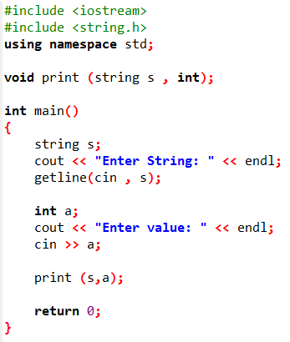
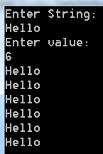
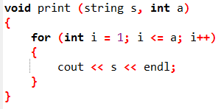

Slide 4
Lab Task 2
Write a function which accept a character and return its ASCII value.

Slide 5
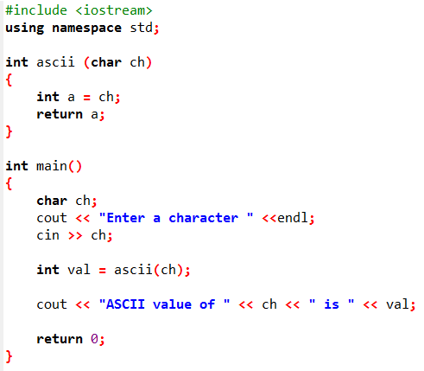


Slide 6
Lab Task 3
Write a function to find whether the character passed as an argument to function is in upper case or lower case.

Slide 7
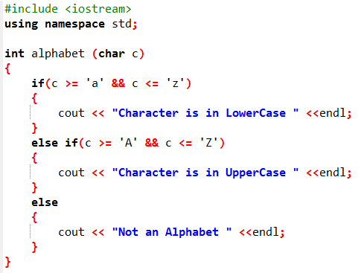

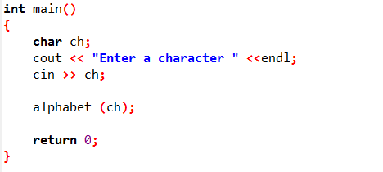

Slide 8
Lab Task 4
Write a function which accept a string and return its length.

Slide 9
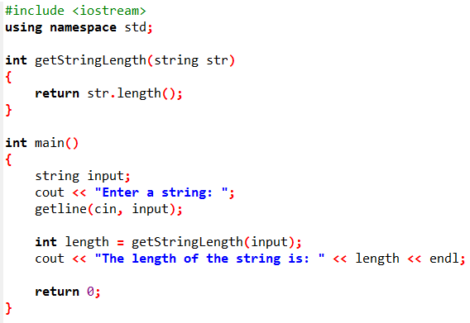


Slide 10
Lab Task 5
Write a function named getNumber that uses a reference parameter variable to accept an integer argument. The function should prompt the user to enter a number in the range of 1 through 100. The input should be validated and stored in the parameter variable.

Slide 11
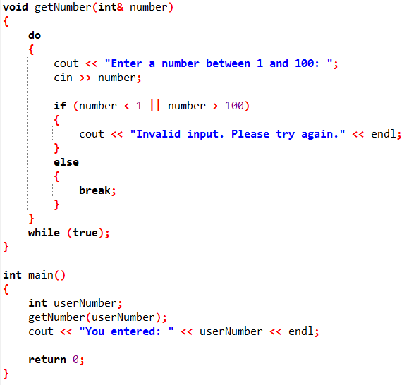

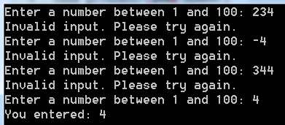
The while (true) loop means that the loop will run indefinitely until it encounters a break statement (or the program is terminated).

